Slide 1

Mitochondria sustain aerobic life

Slide 2
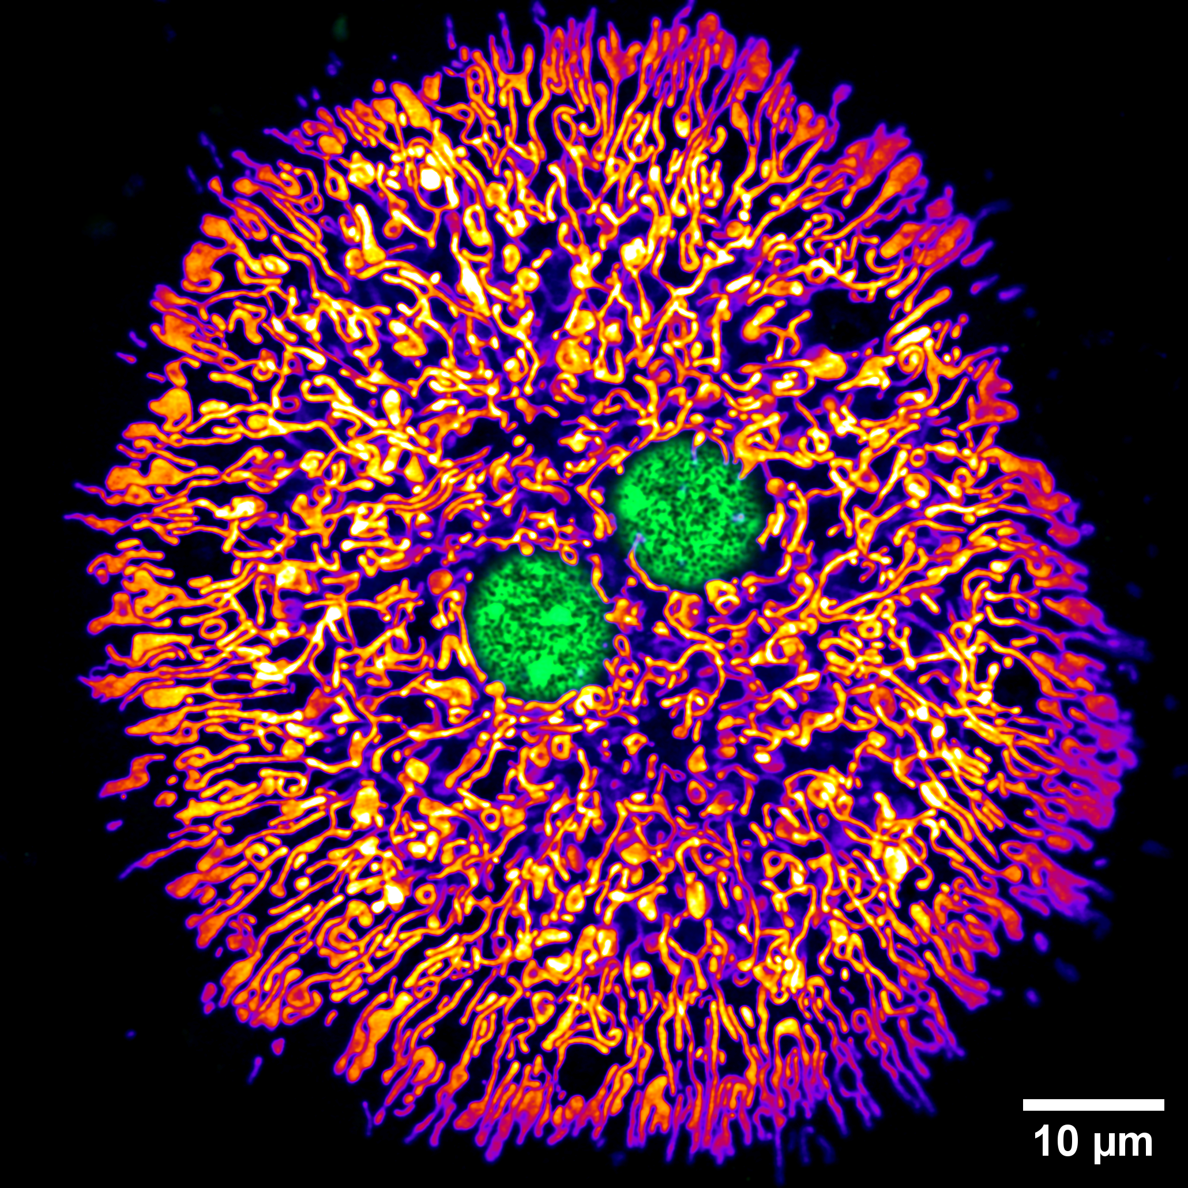
Hepatocyte full of mitochondria
Live-cell Airyscan image of primary murine hepatocyte. Mitochondria were stained with the potentiometric dye, TMRE, and DNA was stained with PicoGreen. TMRE is drawn to mitochondria because of their membrane potential (ΔΨ_{m}). After isolation from the mouse liver, live cells were plated on an imaging dish and imaged with a super-resolution microscope. Hepatocytes are relatively large, metabolically active cells, typically containing two nuclei and a dense mitochondrial reticulum. Image by Dane M. Wolf, PhD, in Shirihai Lab, UCLA.
Eukaryotic cells,
like this
mammalian
liver cell, are practically bursting with mitochondria!
Nuclei
Mitochondria

Slide 3
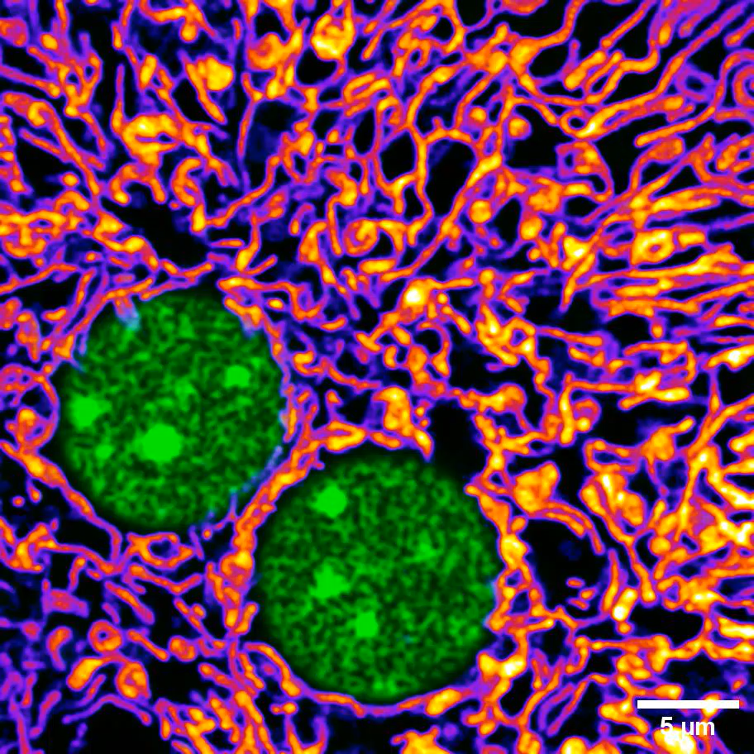
Mitochondria are highly dynamic
Live-cell Airyscan time-lapse image of primary murine hepatocyte. Mitochondria were stained with the potentiometric dye, TMRE, and DNA was stained with PicoGreen. TMRE is drawn to mitochondria because of their membrane potential (ΔΨ_{m}). After isolation from the mouse liver, live cells were plated on an imaging dish and imaged with a super-resolution microscope. Mitochondria are dynamic, continuously moving and undergoing membrane fusion and fission to distribute essential components throughout the population of organelles. Movie by Dane M. Wolf, PhD, in Shirihai Lab, UCLA.
Mitochondria
are highly
dynamic,
constantly moving
and undergoing
fusion and fission!
Nuclei
Mitochondria

Slide 4
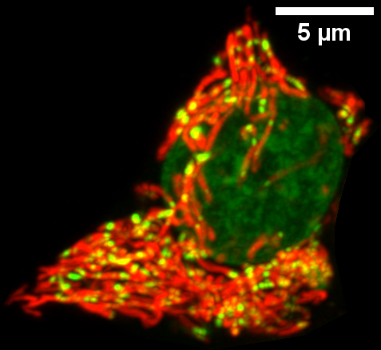
Mitochondria descend from bacteria and maintain their own circular genomes
Live-cell Airyscan image of cultured rat insulinoma (INS-1) cell. Mitochondria were stained with the potentiometric dye, TMRE, and DNA was stained with PicoGreen. TMRE is drawn to mitochondria because of their membrane potential (ΔΨ_{m}). Cells were plated on an imaging dish and imaged with a super-resolution microscope. INS-1 cells are a common cell-culture model of pancreatic β cells, which, in a physiological context, sense glucose from the circulation and secrete insulin. Mitochondria contain numerous copies of a circular genome, reflecting their bacterial origin. Image by Dane M. Wolf, PhD, in Shirihai Lab, UCLA.
Mitochondria
contain many copies of their own genomes, reflecting their bacterial ancestry!
Nucleus
mtDNA
Mitochondria

Slide 5
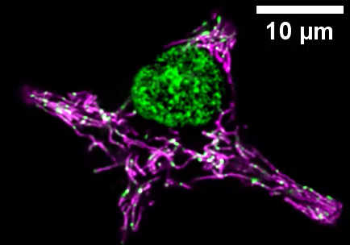
Mitochondrial genomes are also dynamic
Live-cell Airyscan time-lapse image of cultured rat insulinoma (INS-1) cell. Mitochondria were stained with the potentiometric dye, TMRE, and DNA was stained with PicoGreen. TMRE is drawn to mitochondria because of their membrane potential (ΔΨ_{m}). Cells were plated on an imaging dish and imaged with a super-resolution microscope. INS-1 cells are a common cell-culture model of pancreatic β cells, which, in a physiological context, sense glucose from the circulation and secrete insulin. Mitochondria contain numerous copies of a circular genome, reflecting their bacterial origin. Mitochondrial DNA (mtDNA) molecules, like the mitochondria themselves, are constantly in motion, encoding key proteins for oxidative phosphorylation. Movie by Dane M. Wolf, PhD, in Shirihai Lab, UCLA.
These mitochondrial genomes, too, are constantly moving, replicating, and being turned over!
Nucleus
mtDNA
Mitochondria

Slide 6
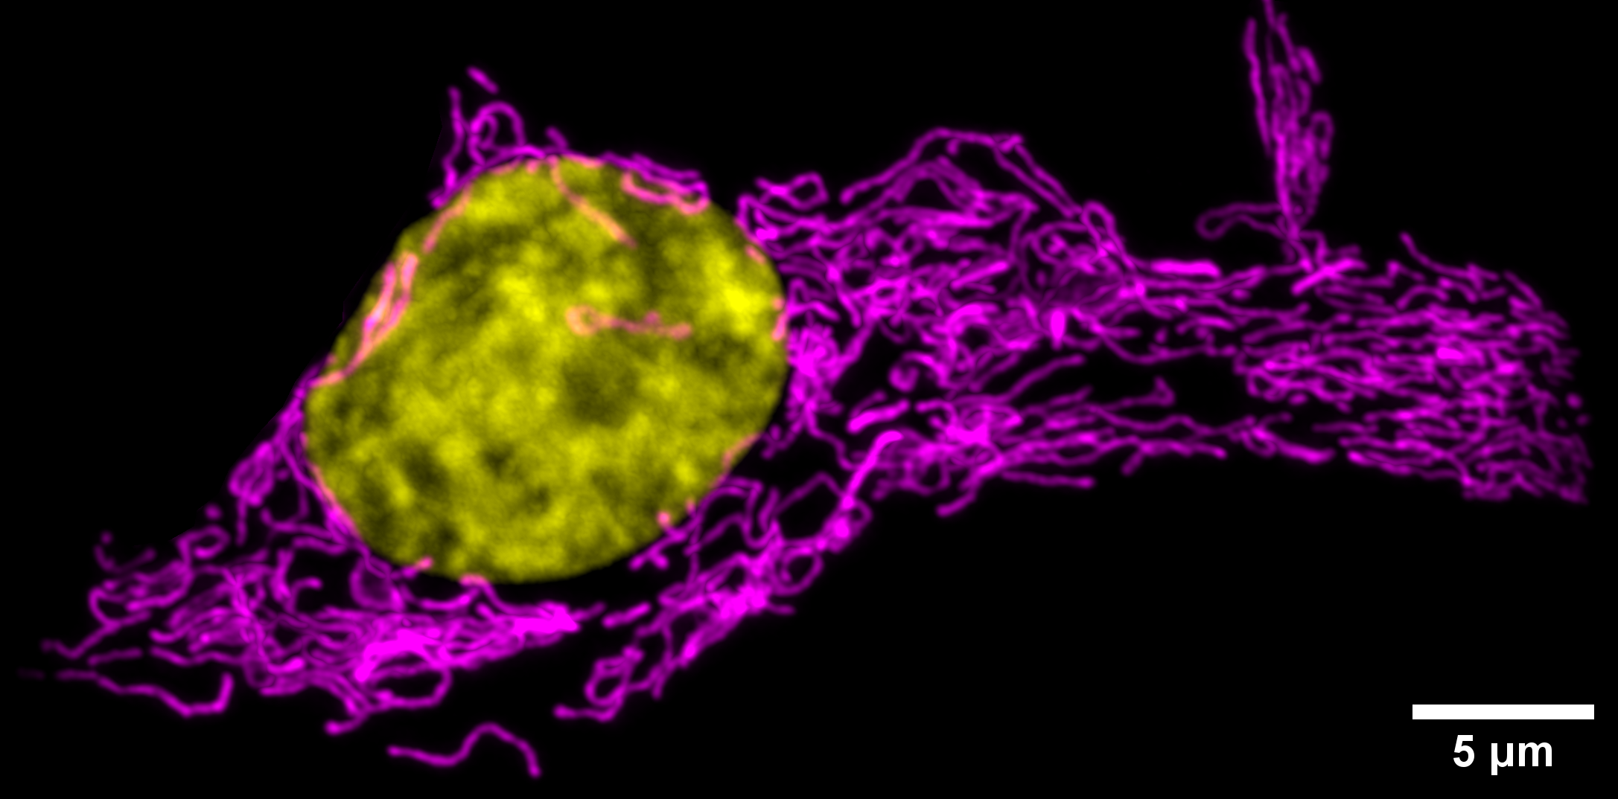
Mitochondria in β cells
promote insulin secretion
Live-cell Airyscan image of cultured rat insulinoma (INS-1) cell. Mitochondria were stained with the potentiometric dye, TMRE, and DNA was stained with Hoechst. TMRE is drawn to mitochondria because of their membrane potential (ΔΨ_{m}). Cells were plated on an imaging dish and imaged with a super-resolution microscope. INS-1 cells are a common cell-culture model of pancreatic β cells, which, in a physiological context, sense glucose from the circulation and secrete insulin. Mitochondria play a key role in the nutrient sensing and signal transduction that enables pancreatic β cells to effectively secrete insulin. Therefore, mitochondrial health is critical for preventing metabolic dysregulation, such as diabetes mellitus. Image by Dane M. Wolf, PhD, in Shirihai Lab, UCLA.
Pancreatic β cells rely on mitochondria to promote essential processes like nutrient sensing and insulin secretion!
Nucleus
Mitochondria

Slide 7
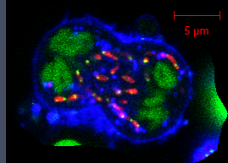
Mitochondria in activated B cells move to daughter cells during mitosis
As activated B cells divide, mitochondria move to each daughter cell to support a robust immune response, such as antibody production.
Live-cell Airyscan time-lapse image of primary, activated mouse B cell. Mitochondria were stained with the potentiometric dye, TMRE, and DNA was stained with PicoGreen. The plasma membrane was stained with a CellMask dye. TMRE is drawn to mitochondria because of their membrane potential (ΔΨ_{m}). Cells were plated on an imaging dish and imaged with a super-resolution microscope. B cells are vital immune cells that generate antibodies to fight infections. Upon activation, B cells undergo mitosis to expand the population of cells to help identify and destroy bacteria, viruses, and other infectious agents. Movie by Dane M. Wolf, PhD, in Shirihai Lab, UCLA.
Plasma membrane
Mitochondria
Chromosomes & mtDNA

Slide 8
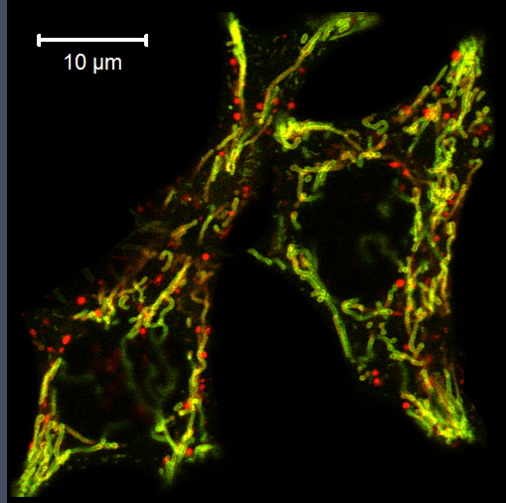
Dysfunctional mitochondria are degraded
Damaged mitochondria are turned over by a process known as mitophagy. The red puncta in this image are mitochondria that have been
eaten by the degradation machinery of the cell.
Live-cell Airyscan time-lapse image of cultured rat insulinoma (INS-1) cell. Mitochondria have been labelled with a tandem fluorescent probe called mitoQC, which shows both the active population of organelles (yellow) as well as the population of mitochondria in the process of degradation (red), contained in acidic lysosomes. Cells were plated on an imaging dish and imaged with a super-resolution microscope. Mitochondria are continuously exposed to oxidative stress and so need to be constantly turned over via a process called mitophagy. Movie by Dane M. Wolf, PhD, in Shirihai Lab, UCLA.
Mitolysosomes
Mitochondria

Slide 9
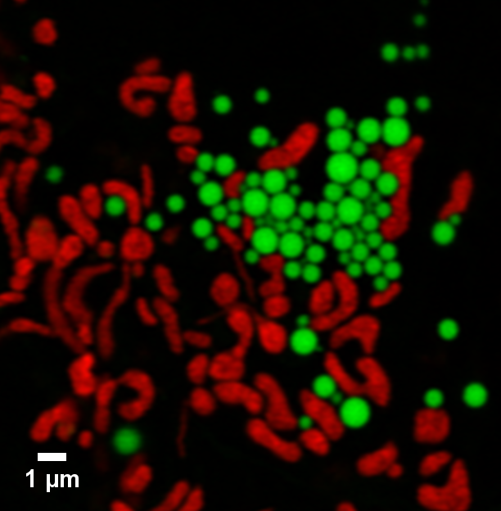
Mitochondria consume fatty acids to make ATP
Live-cell Airyscan image of a cultured liver cell line (Huh7). Mitochondria were stained with the potentiometric dye, TMRE, and lipid droplets were stained with Bodipy. TMRE is drawn to mitochondria because of their membrane potential (ΔΨ_{m}). Cells were plated on an imaging dish and imaged with a super-resolution microscope. Huh7 cells are a common cell-culture model of the human liver, the body’s central metabolic hub. Mitochondria play key roles in both the production and oxidation of lipids in the body. Image by Mayuko Segawa, PhD, in Shirihai Lab, UCLA.
Our body stores energy from food in the form of fatty acids, seen here as green lipid droplets, which mitochondria oxidize to make ATP.
Lipid droplets
Mitochondria

Slide 10
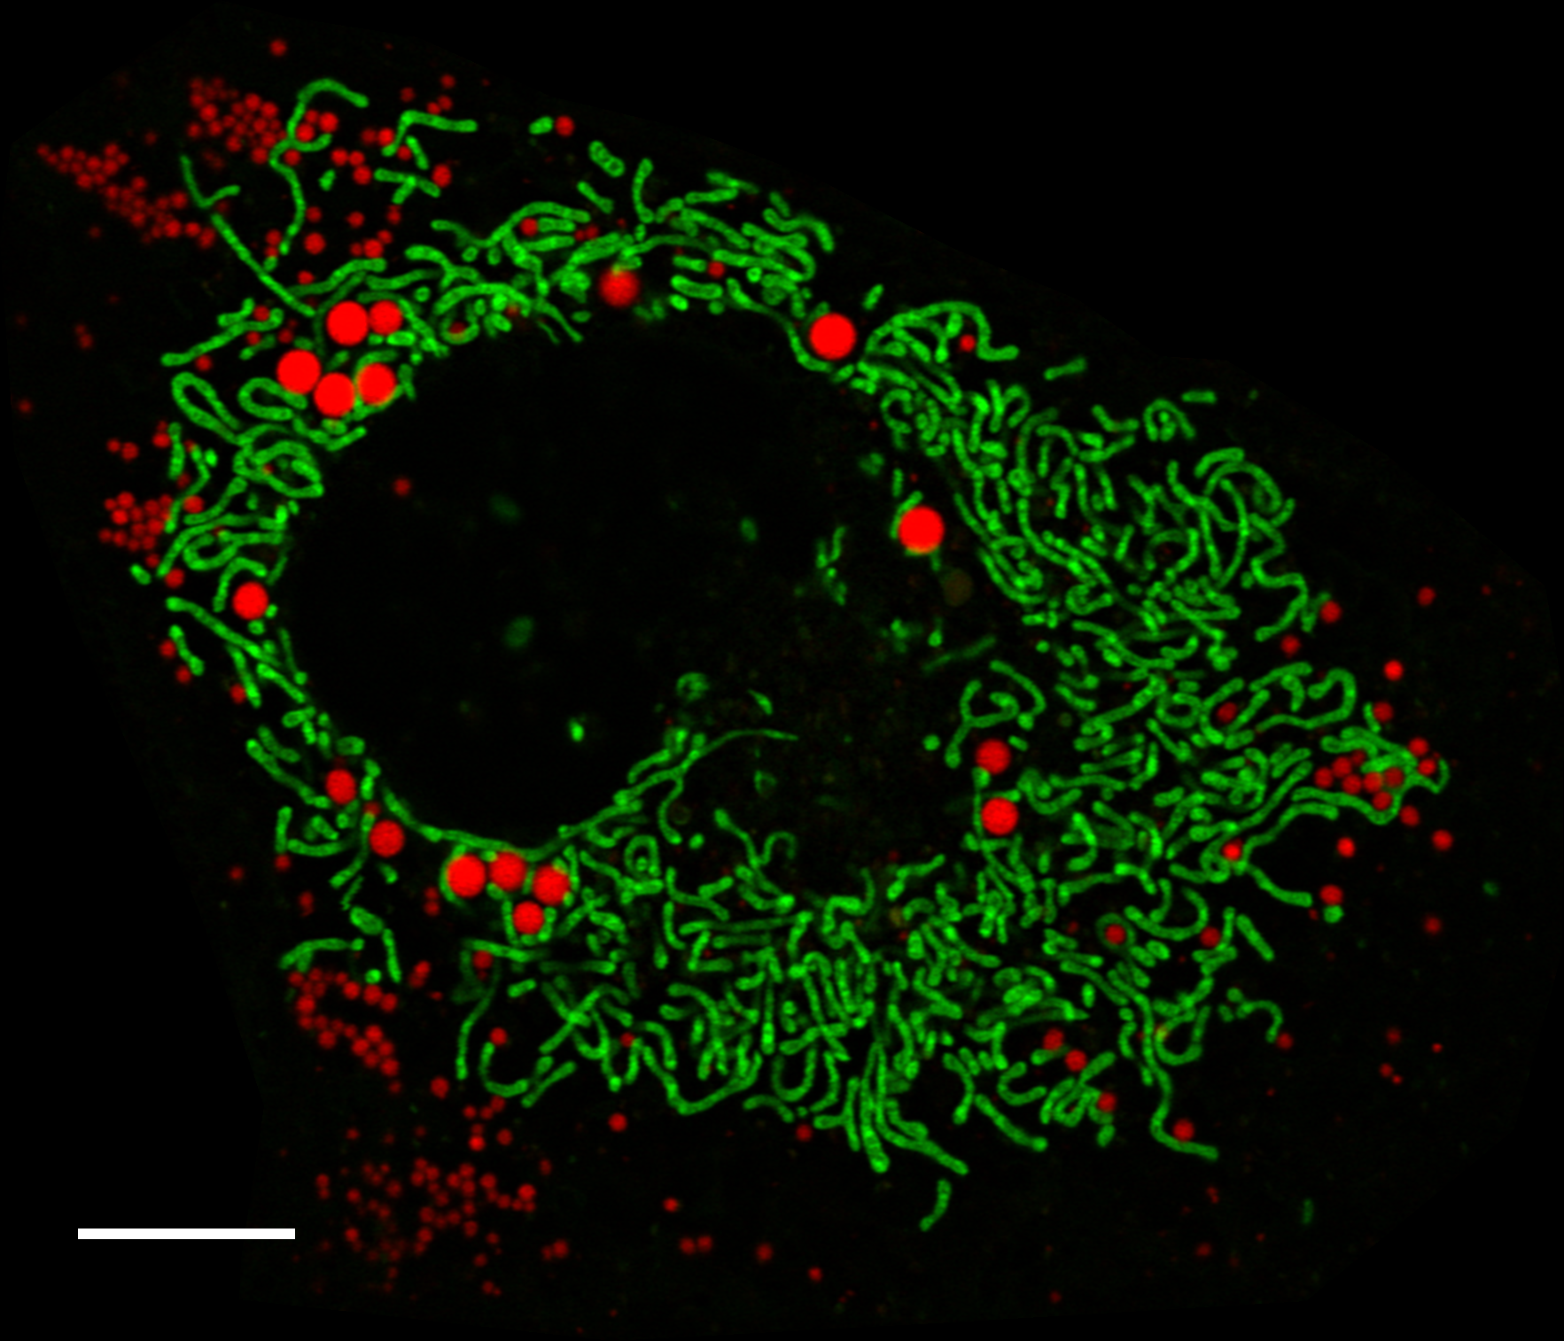
Mitochondria also participate in lipid droplet formation
Live-cell Airyscan image of a cultured liver cell line (Huh7). Mitochondria were stained with the lipophilic, cationic dye, NAO, and lipid droplets were stained with Bodipy. Cells were plated on an imaging dish and imaged with a super-resolution microscope. Huh7 cells are a common cell-culture model of the human liver, the body’s central metabolic hub. Mitochondria play key roles in both the production and oxidation of lipids in the body. Image by Mayuko Segawa, PhD, in Shirihai Lab, UCLA.
Through interactions with the endoplasmic reticulum, mitochondria also participate in lipid droplet formation, important for energy storage and helping buffer cells from the toxic effects of excess free fatty acids.
10 µm
Lipid droplets
Mitochondria

Slide 11
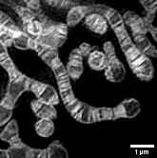
Cristae act as specialized microdomains for ATP synthesis
The inner mitochondrial membrane is highly folded into structures called cristae, which house the machinery of oxidative phosphorylation and serve as bioenergetic microdomains to promote efficient ATP synthesis.
Live-cell structured illumination microscopy (SIM) image of a human cervical adenocarcinoma cell (HeLa). Mitochondria were stained with MitoTracker. Cells were plated on an imaging dish and imaged with a super-resolution microscope. MitoTracker binds covalently to thiol groups of proteins in the inner mitochondrial membrane (IMM). The IMM is highly invaginated into structures called cristae, which function as bioenergetic subunits, specialized for ATP synthesis. Image by Dane M. Wolf, PhD, and Mayuko Segawa, PhD, in Shirihai Lab, UCLA.
Mitochondrial Cristae

Slide 12
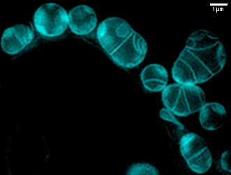
Dysregulation of cristae structure and density is a hallmark of many diseases
Live-cell structured illumination microscopy (SIM) image of a human cervical adenocarcinoma cell (HeLa). Mitochondria were stained with MitoTracker. Cells were plated on an imaging dish and imaged with a super-resolution microscope. Mitochondria were treated with an uncoupler, dissipating the membrane potential. Image by Dane M. Wolf, PhD, and Mayuko Segawa, PhD, in Shirihai Lab, UCLA (Segawa et al., 2020).
Mitochondrial dysfunction is associated with fragmentation and aberrant cristae structure and density. Maintaining mitochondrial architecture is critical for maintaining cellular and systemic health!

Slide 13


Healthy mitochondria help you go the distance!
Dane M. Wolf, PhD

